Slide 1
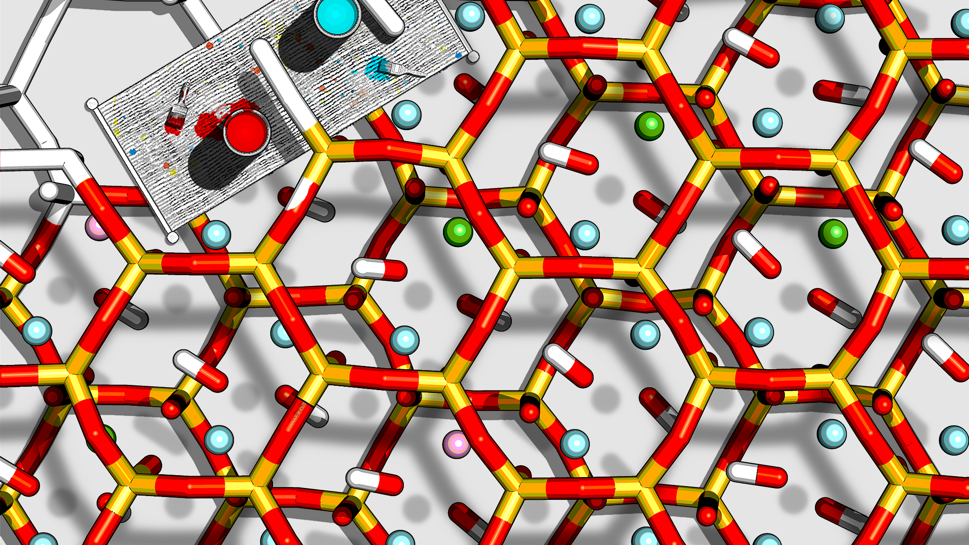
Computational Techniques in Chemistry
Session 2:
Introduction to molecular dynamics simulations
Valentina Erastova University of Edinburgh
January 2025
Big thanks to Matteo Degiacomi (matteo.degiacomi@ed.ac.uk) and Hannah Pollak (h.pollak@sms.ed.ac.uk for material development

Slide 2
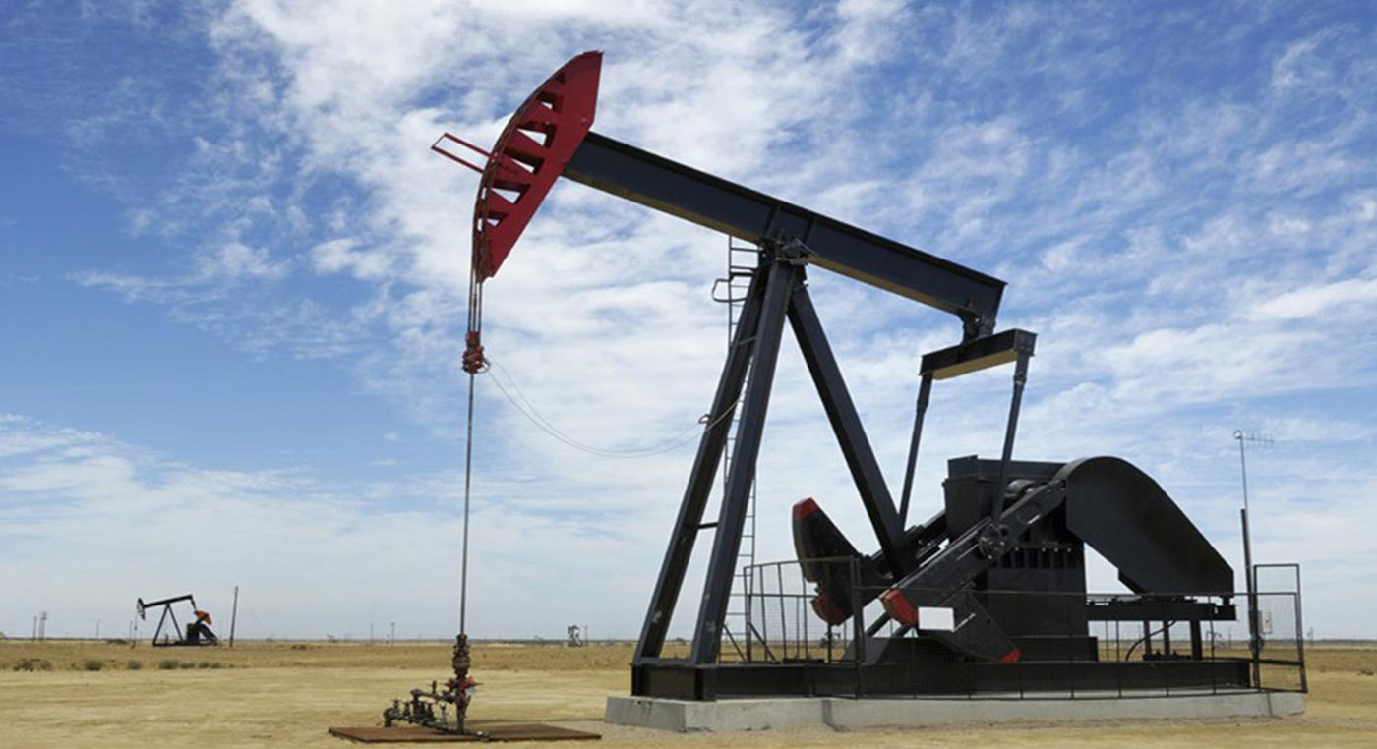


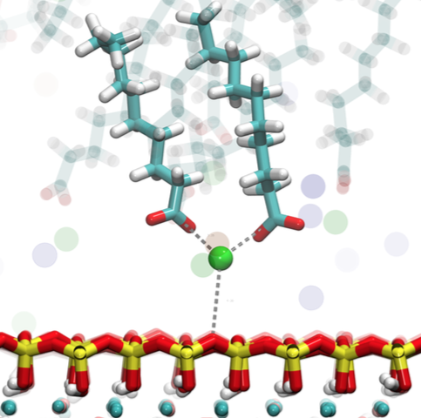
Molecular Modeling
WHY?
Not every property can be measured experimentally
Experiments can be expensive, time consuming or dangerous
WHAT?
Theoretical/computational techniques
Simulate properties/behavior of molecules
WHEN?
Predictive or analytical tool for properties that experiments cannot measure
Rationalize experimental data and guide further work

Slide 3
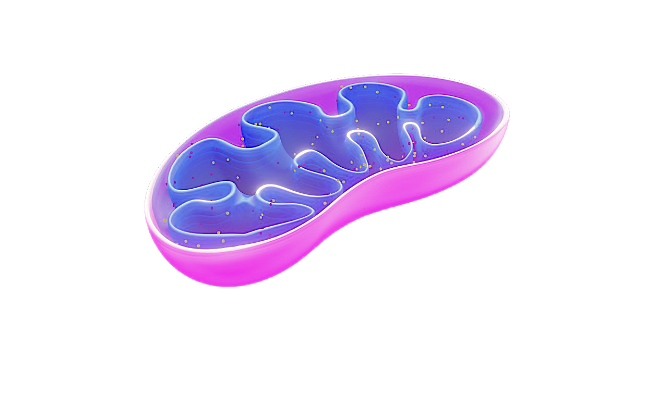
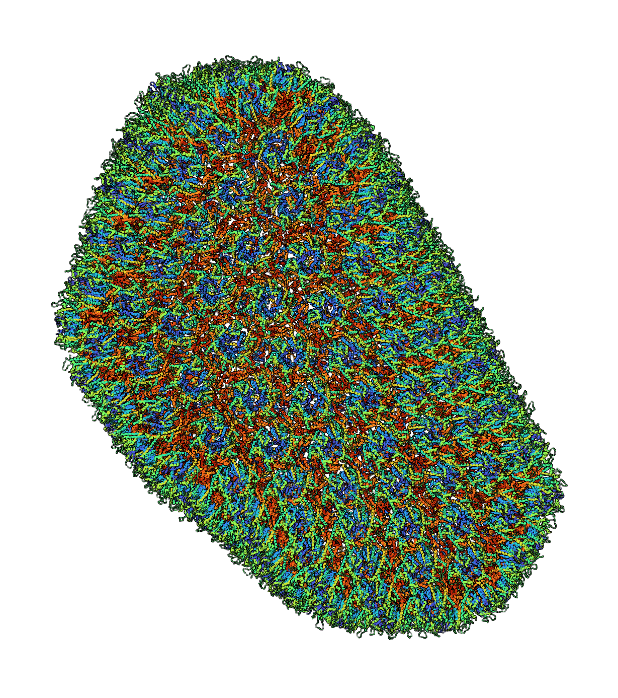
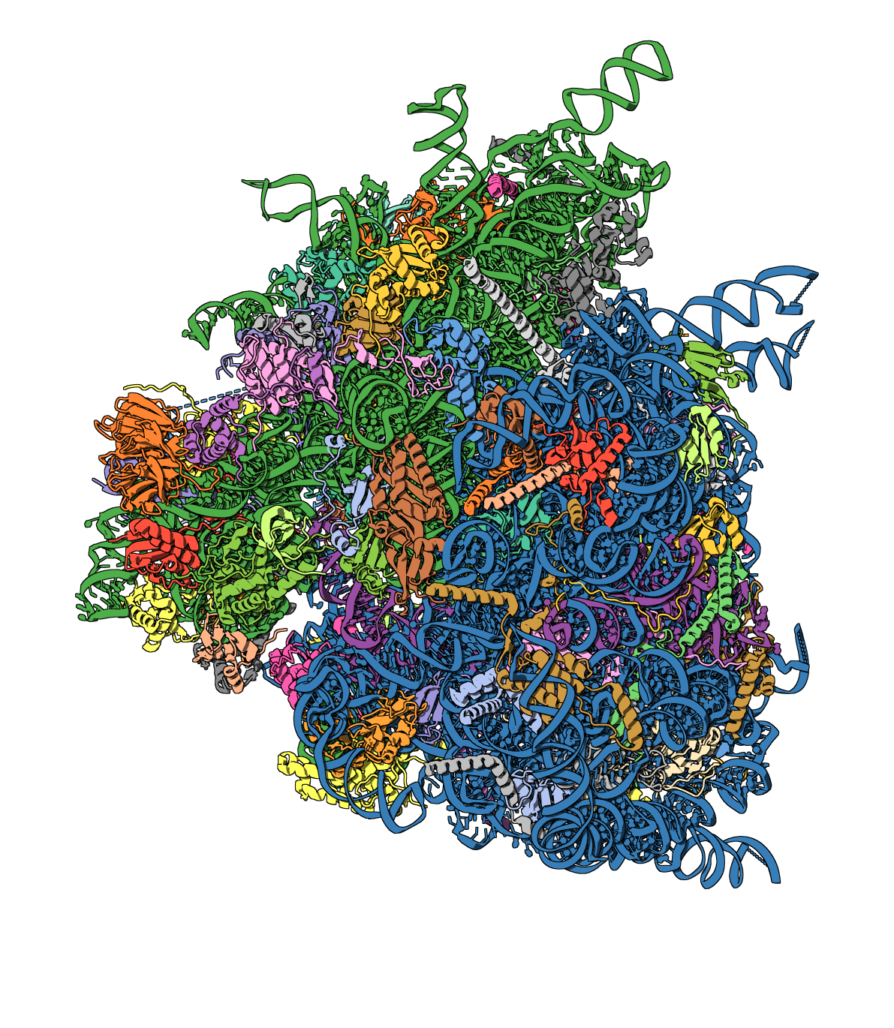
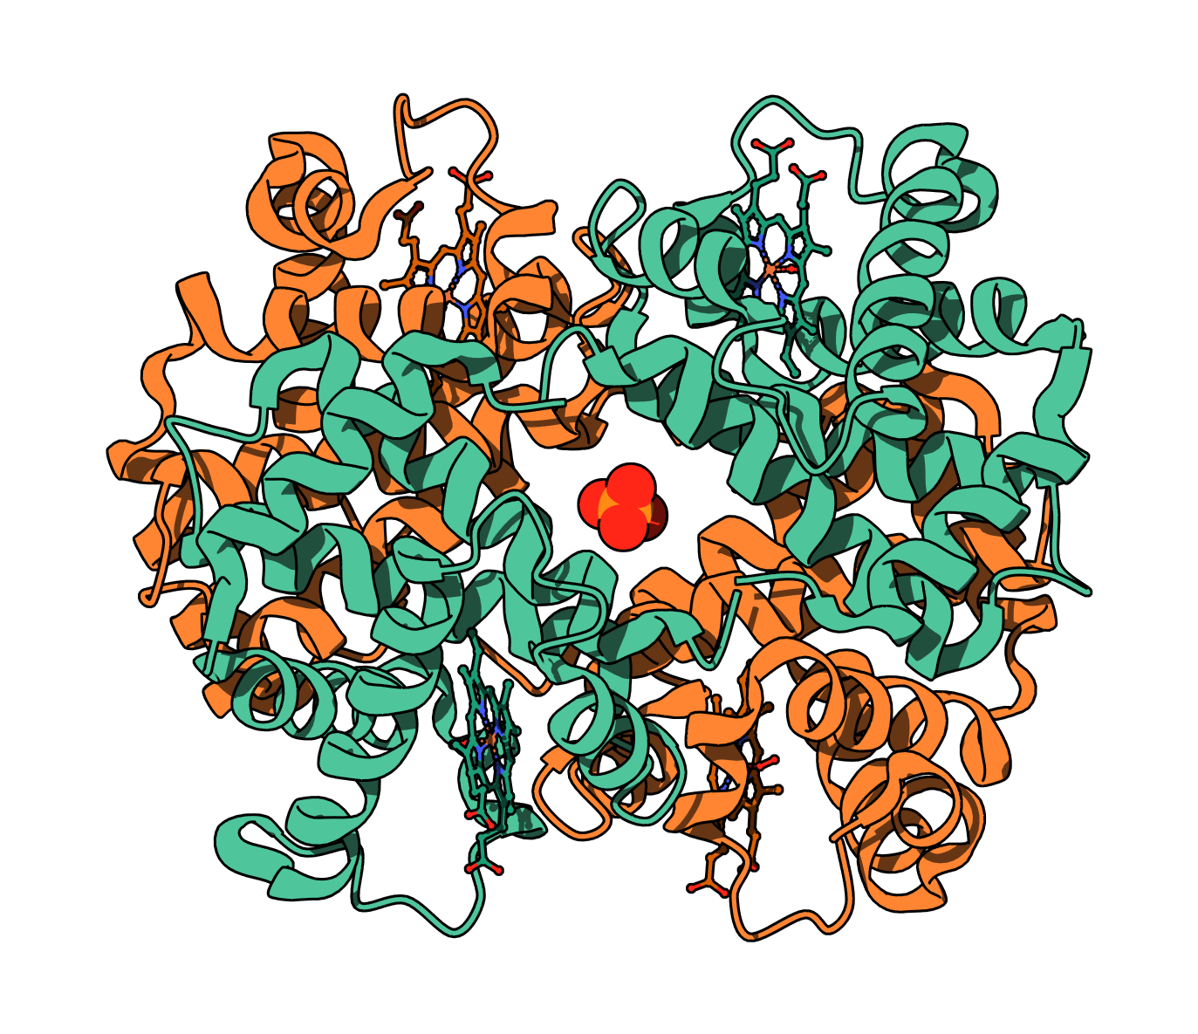
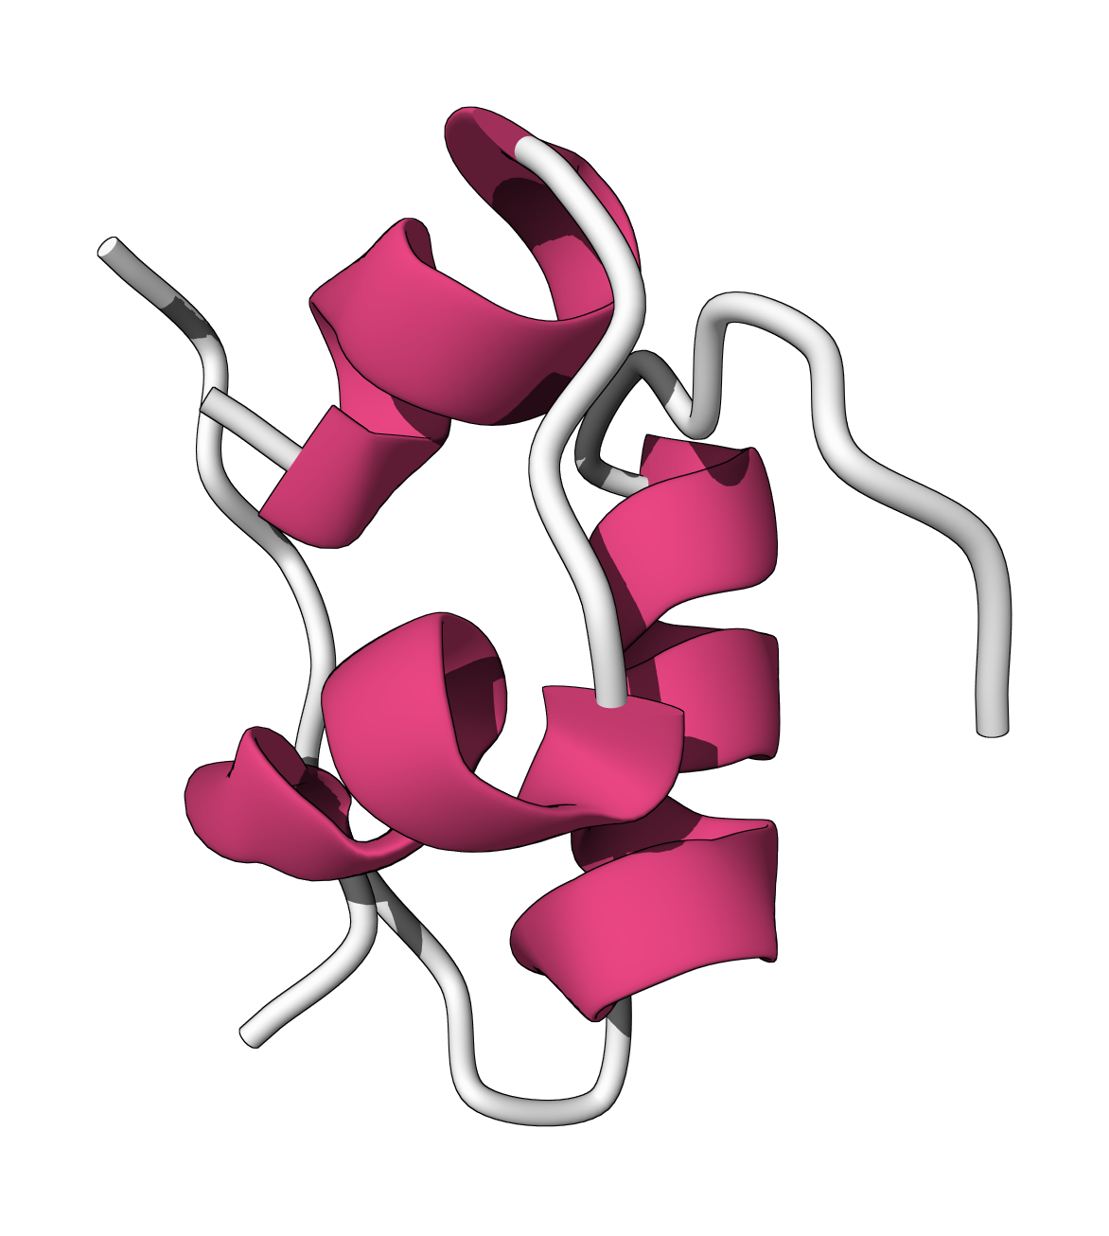
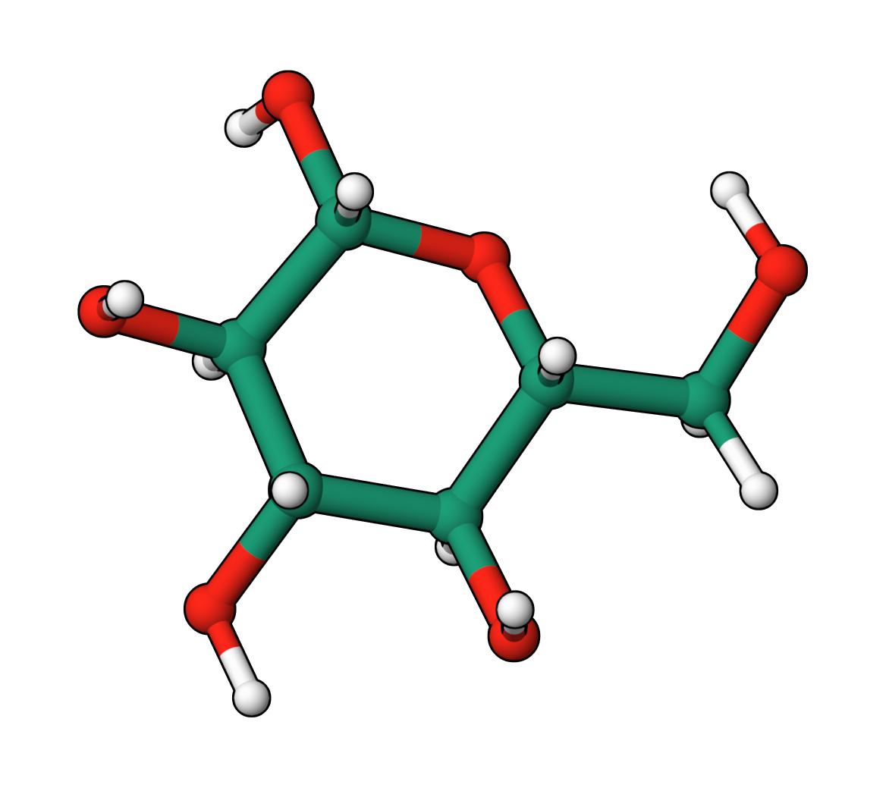
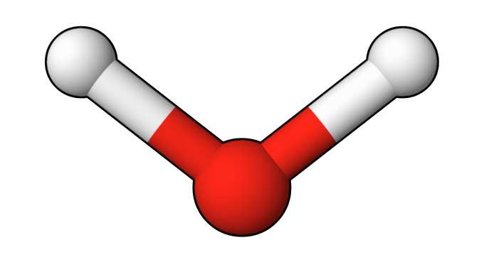
10⁻⁶
length [m]
mitochondria
10⁻⁷
HIV-1 virus
10⁻⁸
ribosome
haemoglobin
10⁻⁹
insulin
glucose
O-H bond
10⁻¹⁰
10⁻¹⁵
10⁻¹²
10⁻⁹
10⁻⁶
10⁻³
10⁰
10³
time [s]
femto-
pico-
nano-
micro-
milli-
light absorption
proton transfer
side-chain flip
2^{ndary} structure formation
protein translation
electron transfer
solute permeation
thermally-driven reactions

Slide 4
10⁻⁶
Schrödinger equation
Exact only for H and He
Approximations:
ab-initio: directly derived
semi-empirical and empirical: fitted to experiments
Properties that cannot be isolated: transition & excited states
~100 of atoms, ps motions
length [m]
mitochondria
10⁻⁷
HIV-1 virus
10⁻⁸
ribosome
haemoglobin
10⁻⁹
insulin
glucose
O-H bond
10⁻¹⁰
10⁻¹⁵
10⁻¹²
10⁻⁹
10⁻⁶
10⁻³
10⁰
10³
time [s]
femto-
pico-
nano-
micro-
milli-
light absorption
proton transfer
side-chain flip
2^{ndary} structure formation
protein translation
electron transfer
solute permeation
thermally-driven reactions

Slide 5
10⁻⁶
length [m]
mitochondria
10⁻⁷
HIV-1 virus
10⁻⁸
ribosome
Quantum
Chemistry
haemoglobin
Newtonian Mechanics
Each atom is a bead,
connected by a spring
~100k of atoms, ns - µs
10⁻⁹
insulin
glucose
O-H bond
10⁻¹⁰
10⁻¹⁵
10⁻¹²
10⁻⁹
10⁻⁶
10⁻³
10⁰
10³
time [s]
femto-
pico-
nano-
micro-
milli-
light absorption
proton transfer
side-chain flip
2^{ndary} structure formation
protein translation
electron transfer
solute permeation
thermally-driven reactions

Slide 6
10⁻⁶
length [m]
Molecular Mechanics
mitochondria
10⁻⁷
HIV-1 virus
10⁻⁸
ribosome
Quantum
Chemistry
haemoglobin
10⁻⁹
insulin
QM/MM
glucose
O-H bond
10⁻¹⁰
10⁻¹⁵
10⁻¹²
10⁻⁹
10⁻⁶
10⁻³
10⁰
10³
time [s]
femto-
pico-
nano-
micro-
milli-
light absorption
proton transfer
side-chain flip
2^{ndary} structure formation
protein translation
electron transfer
solute permeation
thermally-driven reactions

Slide 7
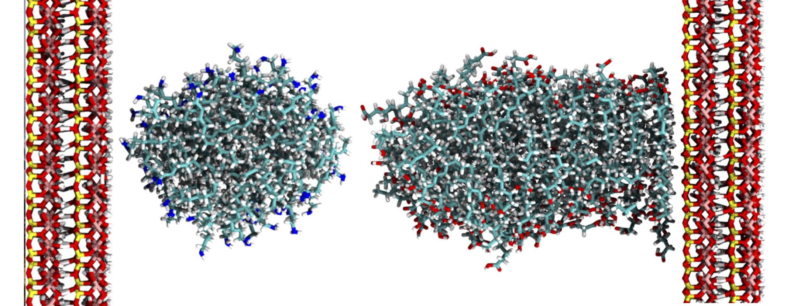
Molecular Mechanics or Force Field Methods

Slide 8
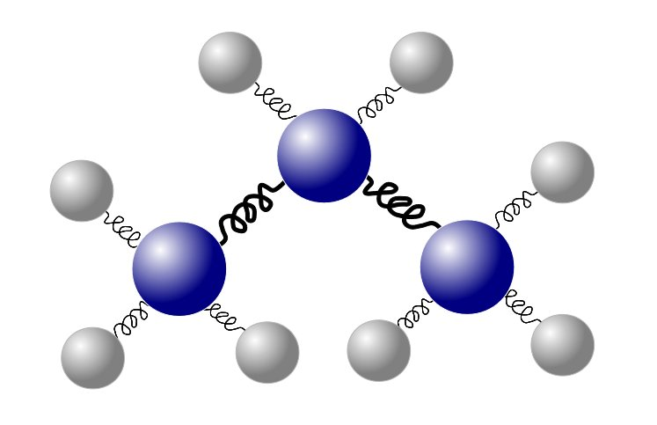
Force Field Methods
A molecule is represented by a set of balls connected with springs
System’s energy depends on classical interactions between balls and springs
Interactions are described by pre-assigned parameters = force fields

Slide 9
Force Field Methods
A molecule is represented by a set of balls connected with springs
System’s energy depends on classical interactions between balls and springs
Interactions are described by pre-assigned parameters = force fields
ASSUMPTIONS:
Nuclei and electrons are combined in an atom, represented by a ball
Balls have radius, constant charge and a given softness
Covalent bonds are represented by springs
Springs have an equilibrium length and can vary in stiffness

Slide 10
Force Field Energy
Force Field - set of parameters used in classical mechanical calculations
Potential Energy - the sum of all the interactions in it
E_{FF} =E_{str} +E_{bend} +E_{tors} +E_{VdW} +E_{el}
bonded
non-bonded

Slide 11
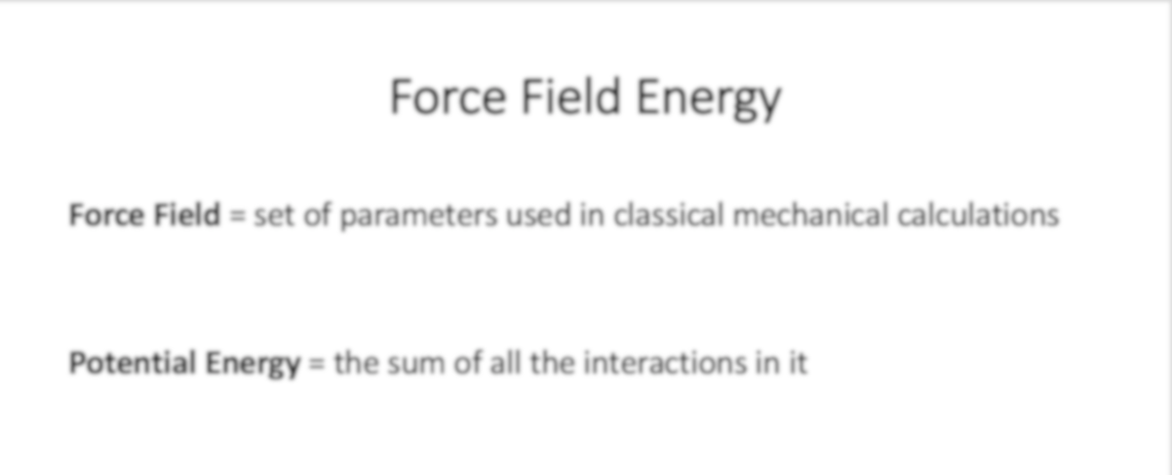
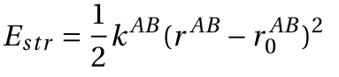
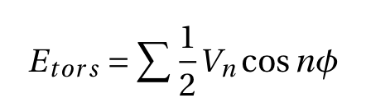
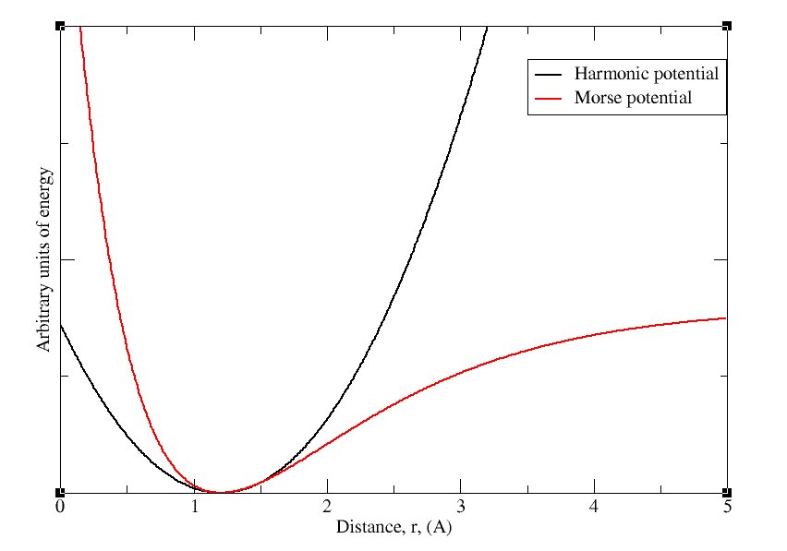
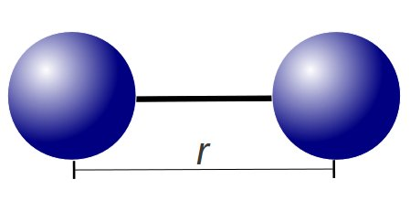
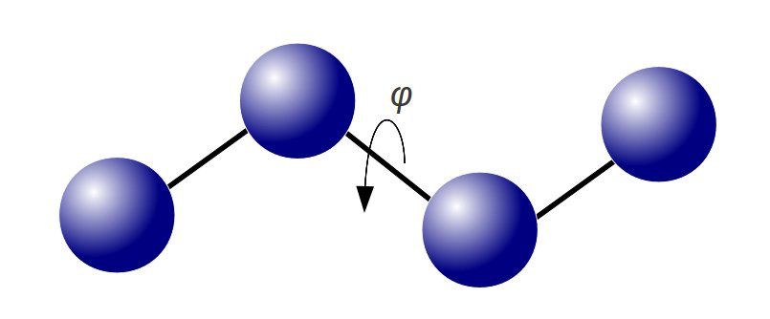
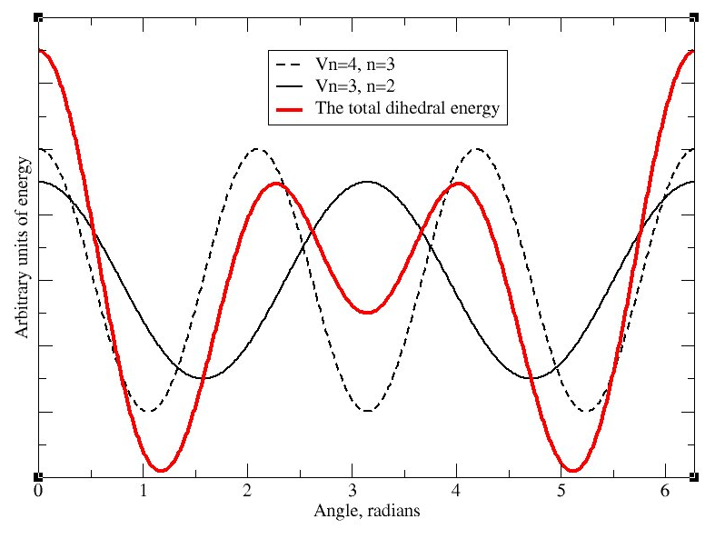
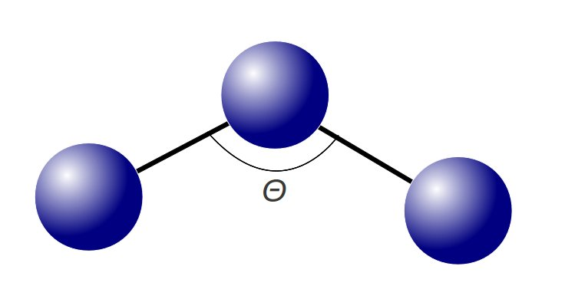
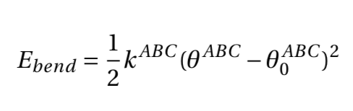
Force Field Energy
Bond Stretch
Torsion
Force Field = set of parameters used in classical mechanical calculations
Potential Energy = the sum of all the interactions in it
E_{FF} =E_{str} +E_{bend} +E_{tors} +E_{VdW} +E_{el}
Bend
bonded
non-bonded
Notes:
Mention strength of interaction, and the constant

Slide 12
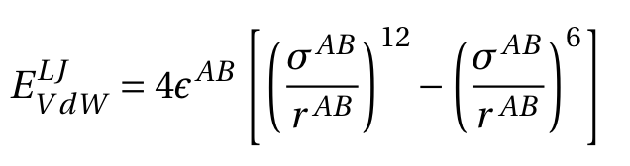
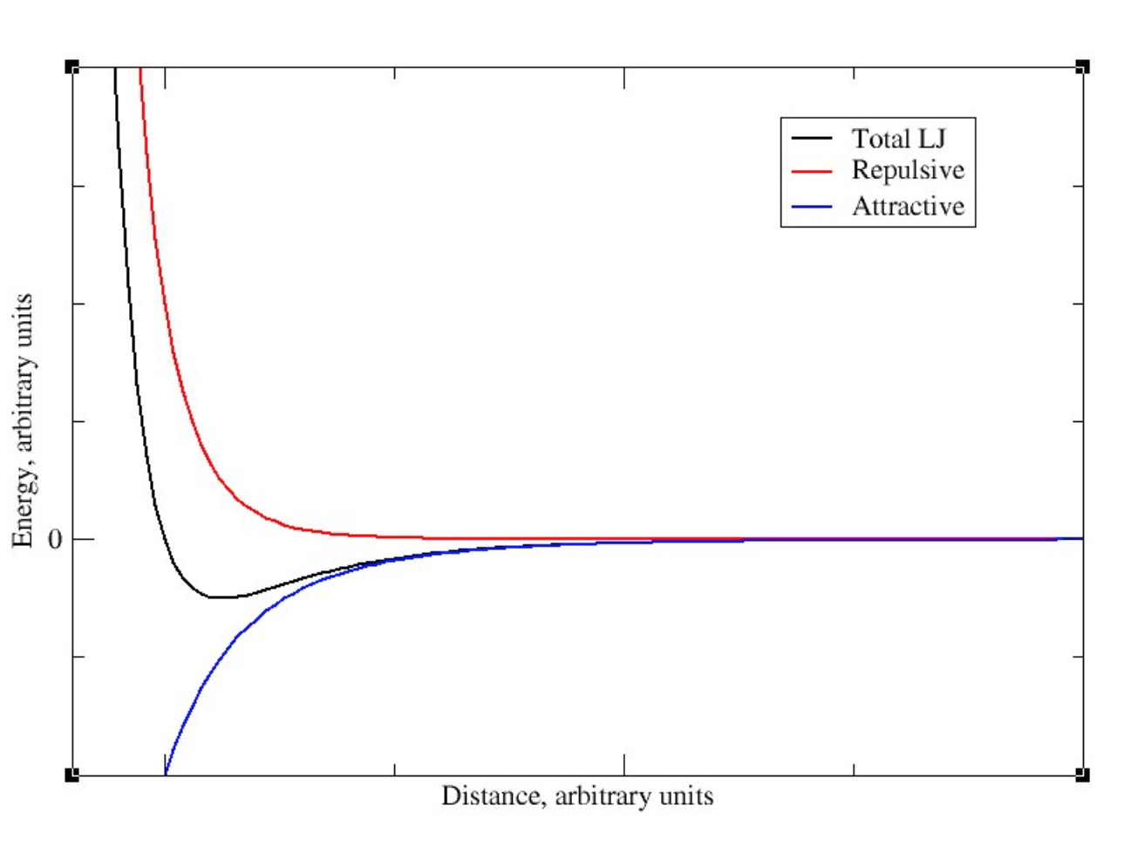

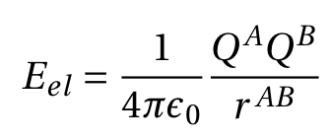
Force Field Energy
Lennard-Jones
Force Field = set of parameters used in classical mechanical calculations
Potential Energy = the sum of all the interactions in it
E_{FF} =E_{str} +E_{bend} +E_{tors} +E_{VdW} +E_{el}
Coulomb
bonded
non-bonded

Slide 13
Force Field Methods
Monte Carlo
probes the conformational space by random insertions to generate Boltzmann distribution of states
Molecular Dynamics
probes conformational space and dynamical properties (Energy Landscape)

Slide 14
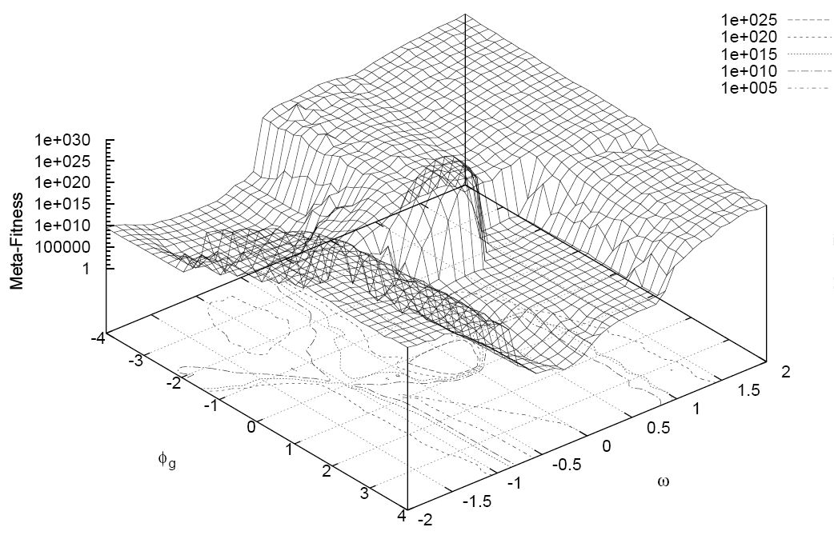
Energy Landscape
Atoms interact, generate forces
Sum of all interactions generates an energy landscape
Energy landscape determines atoms motion

Slide 15
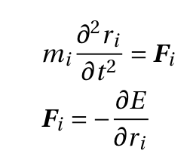
Energy Landscape
Classical equations of motion are solved step-by-step, by a finite difference algorithm
Newton’s II law of motion for a simple system is:
m_{i} a

Slide 16

Trajectory:
(x₃,v₃)
(x_{T},v_{T})
?
!
(x₀,v₀)
(x₂,v₂)
(x₁,v₁)
A trajectory can be decomposed in small uniform steps
Step size depends on energy landscape steepness

Slide 17
How to choose this sampling time?
sharpest gradient = highest frequency
Highest frequencies:
Covalent bond hydrogen - heavy atom (10¹⁴ Hz): 0.5 fs
Covalent bond heavy atom - heavy atom: 1 fs
Angles fluctuations: 2 fs
Restraining covalent bonds or angles allows to increace timesteps
SHAKE, RATTLE, LINCS,…

Slide 18
How to control temperature and pressure?
Simulations can replicate a specific thermodynamic ensemble
typically NVT or NPT
Addition of equations acting as
thermostats (scaling atom velocities)
barostats (scaling positions)
e.g.: Berendsen, Nose-Hoover, Parrinello-Rahman, …

Slide 19
Is the simulation box finite?
For bulk properties use periodic boundary conditions (PBC)
For boundary effects use wall, PBC in xy-direction, vacuum in NVT, …
…
…

Slide 20
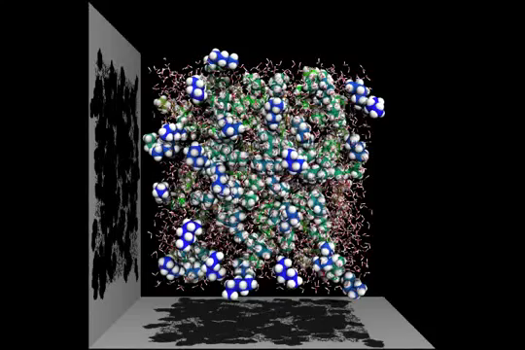
In each timestep…
Set initial conditions for x, v and box size
Compute forces
Compute new x’ and v’ for all atoms
Scale x’ and v’ with thermo/barostat
Update x’ and v’ (with pbc)
Video by MDsimulator. Link: https://youtu.be/xcMSHy3CqXA

Slide 21
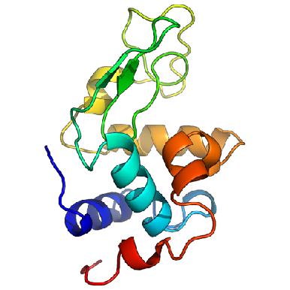
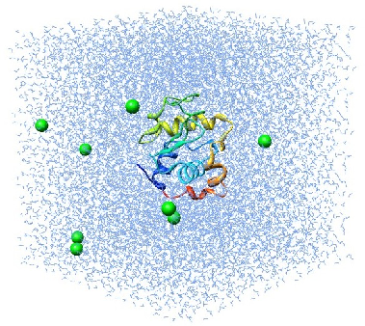
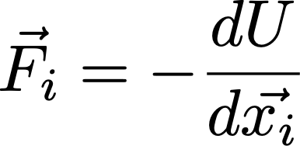
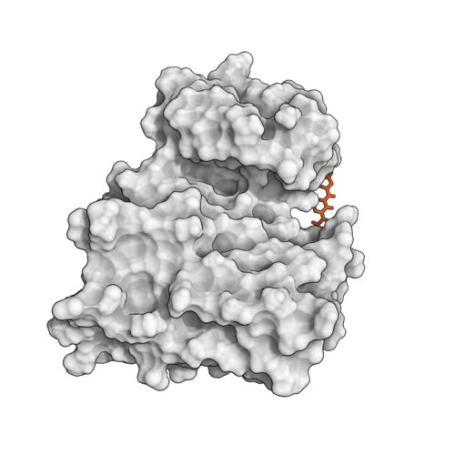
Molecular dynamics require multiple steps for the setup of simulations
Disulphide bridges
Protonation
Solvate in water and add ions
(typically, neutralize the system)
Crystal Waters
Cofactors
Alternative side chains
Solvated protein
Apply forcefield description
NVT/NPT equilibration
Minimize the positions
Equilibrated system
Solvated protein + forcefield
minimized protein
Production simulation
http://www.bevanlab.biochem.vt.edu/Pages/Personal/justin/gmx-tutorials/lysozyme/01_pdb2gmx.html
Levitt, Nature Struct. Biol., 2001

Slide 22
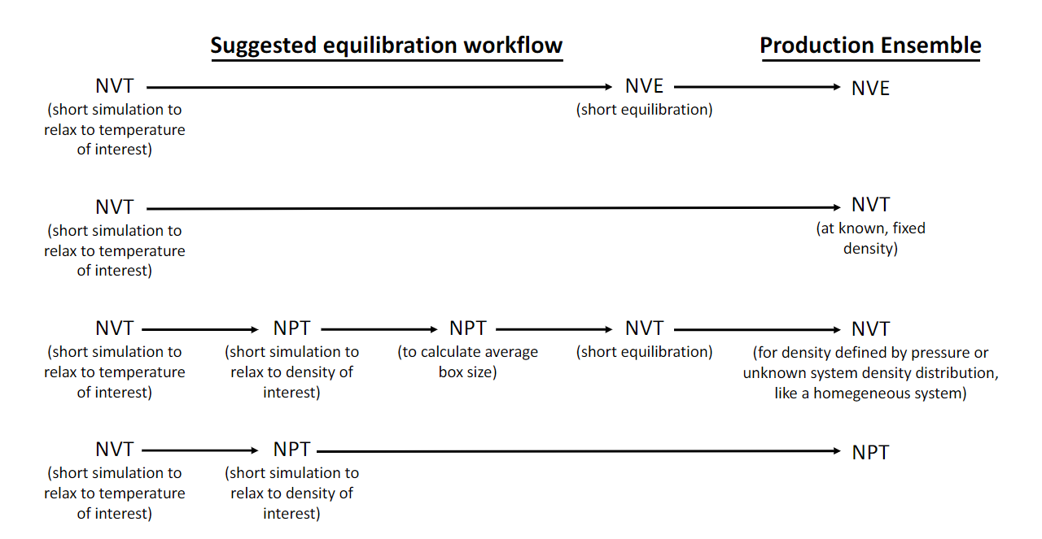
Example equilibration protocols
YOU WANT: constant energy, volume, pressure, temperature, no exotic chemistry, …
Living J. Comp. Mol. Sci. 2019, 1, 5957
Notes:
Common equilibration work-flows are shown; these vary depending on the target ensemble for production simulations (right). Typically, an Initial phase of equilibration at constant volume and temperature Is needed to bring the system to the desired target temperature or energy. For stability reasons, this initial phase is usually needed even if the goal is to also bring the system to a target pressure. If the production ensemble Is an NVE ensemble, an Initial NVT simulation Is usually followed by a short additional NVE equilibration before collection of production data. If the production ensemble is NVT, protocols may differ depending on whether it is necessary to allow the system to equilibrate to a particular denslty/volume or whether the volume Is selected a priori(second and third rows). And If production Is to be NPT, It Is usually equilibrated first at NVT before equilibrating to the target pressure (final row).

Slide 23
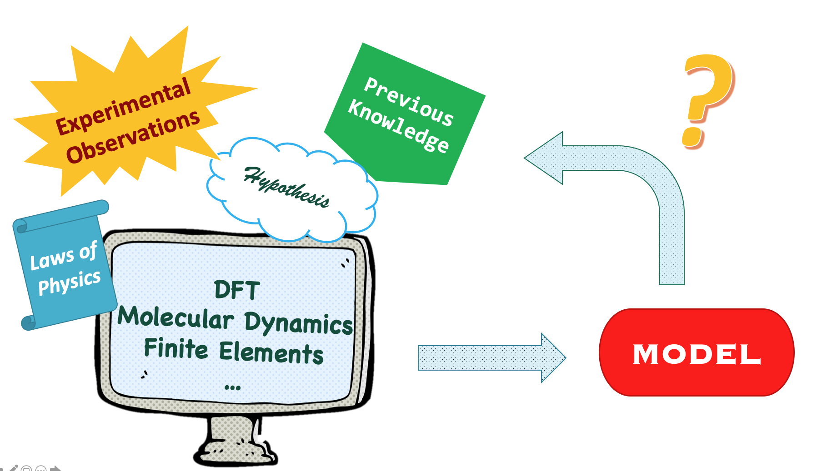
What do I need to MD?
RESOURCES
Computational Power
MD Software
Force Fields
INFORMATION
Hypothesis!
What is the Process?
Chemical/Physical
Timescales of this Process
Molecular Structures

Slide 24
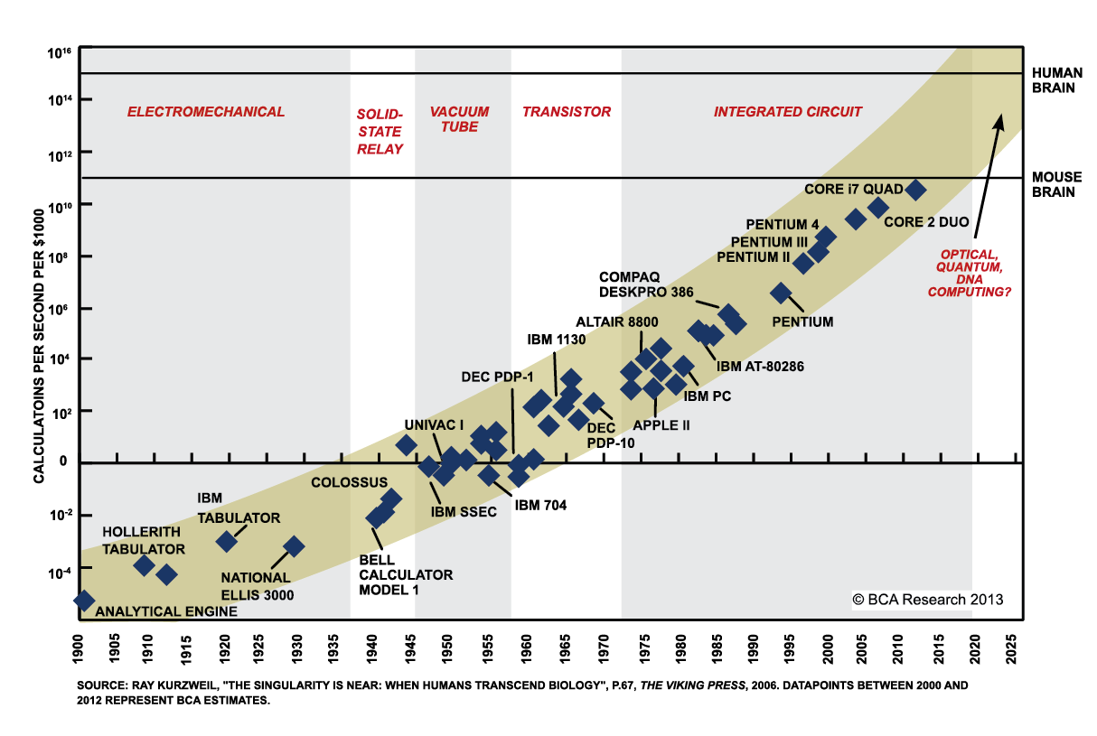
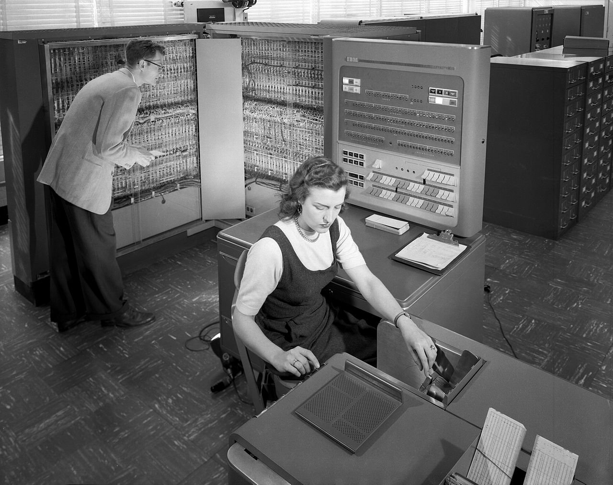
Computational Power
on a supercomputer 24/7 for several weeks
Calculation time affected by:
Processor power
Number of processors
Interconnect speed
IBM 704

Slide 25
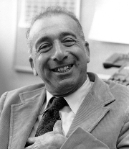
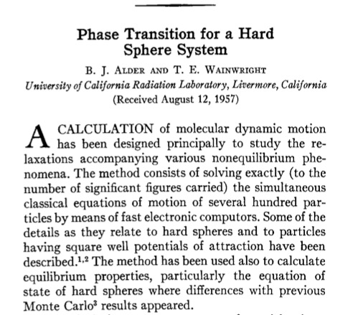
Computational Power
on a supercomputer 24/7 for several weeks
Berni Alder
IBM 704

Slide 26
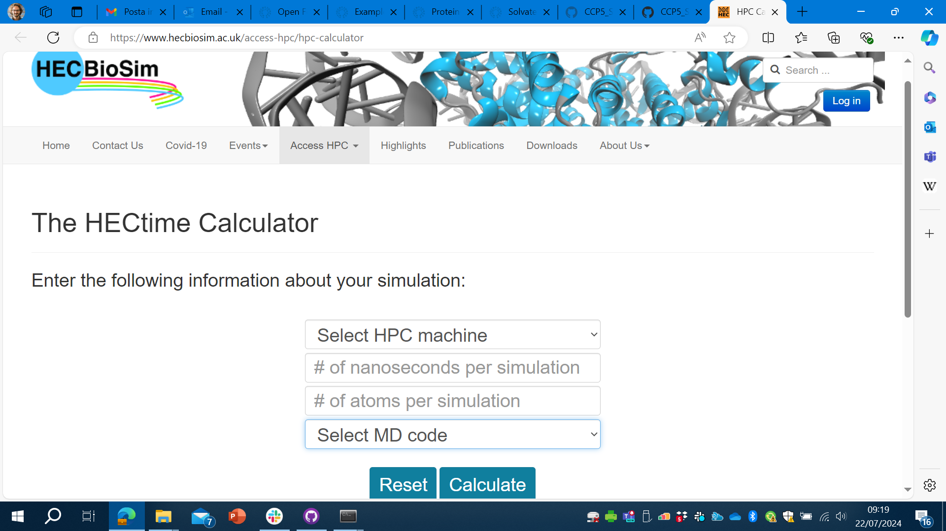
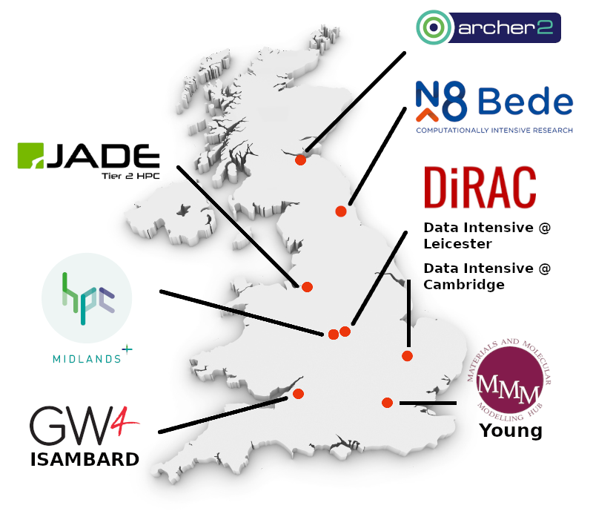
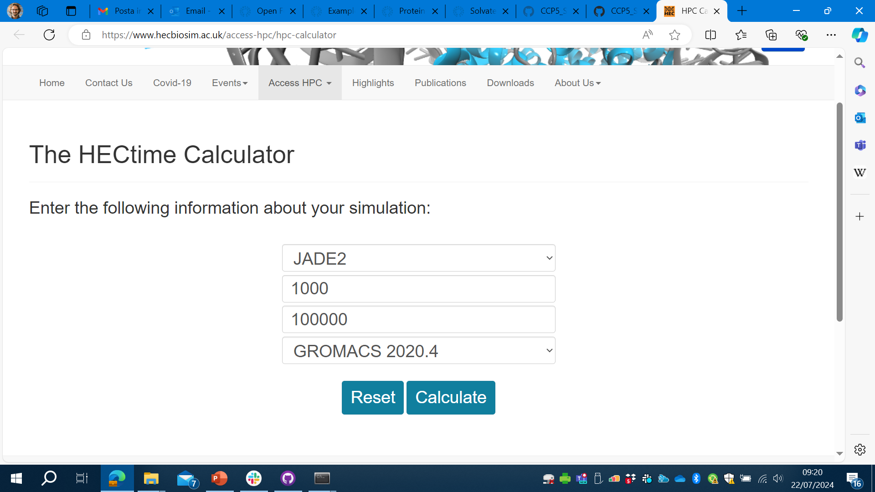
Calculating runtimes: example on UK Tier 2 systems
[as of 2024]
https://www.hecbiosim.ac.uk/access-hpc/hpc-calculator
26

Slide 27
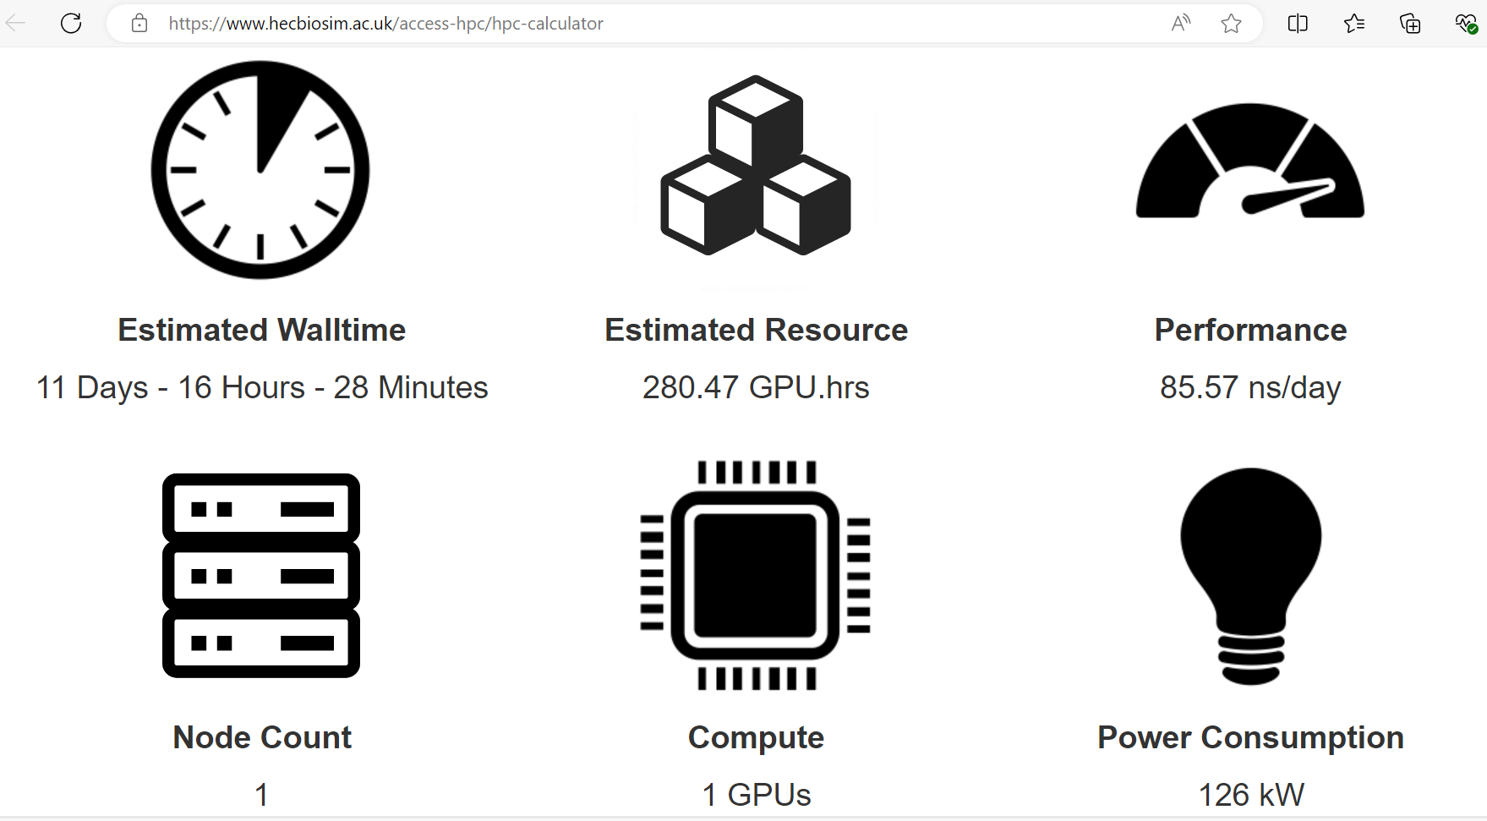
Calculating runtimes: example on UK Tier 2 systems
[as of 2024]
https://www.hecbiosim.ac.uk/access-hpc/hpc-calculator
27

Slide 28

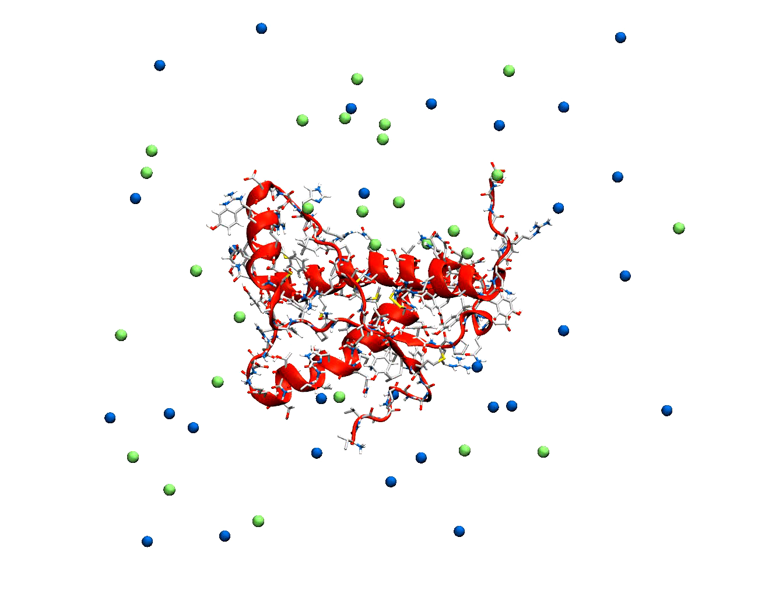
Now let’s start with setting up your first simulation!

